Slide 1
Listen Up!
Discovering Birds with Technology
A lesson from WREN — Wildlife Research and Education Network
Powered by BirdNet-Go & Raspberry Pi

Slide 2
What is WREN? 🐦
🌿
📚
🌎
Wildlife Research
Education
Global Impact
We study the birds living right in your schoolyard and neighborhood using cool technology!
We bring hands-on science lessons to schools so students like you can do real research.
The data your school collects gets shared with scientists around the world!
WREN = Wildlife Research and Education Network

Slide 3
Why Do Birds Matter? 🦅
🌱
Seed Spreaders
3 Billion
Birds carry seeds in their beaks and stomachs, planting new trees across forests.
🐛
Pest Controllers
birds lost in
North America
since 1970
Birds eat billions of insects each year — they're nature's pest control!
🌸
Pollinators
Hummingbirds and others pollinate flowers just like bees do.
that's why
monitoring matters!
📡
Environmental Sensors
When birds disappear, it signals something is wrong with our environment.
Birds are bioindicators — their health tells us how OUR environment is doing.

Slide 4
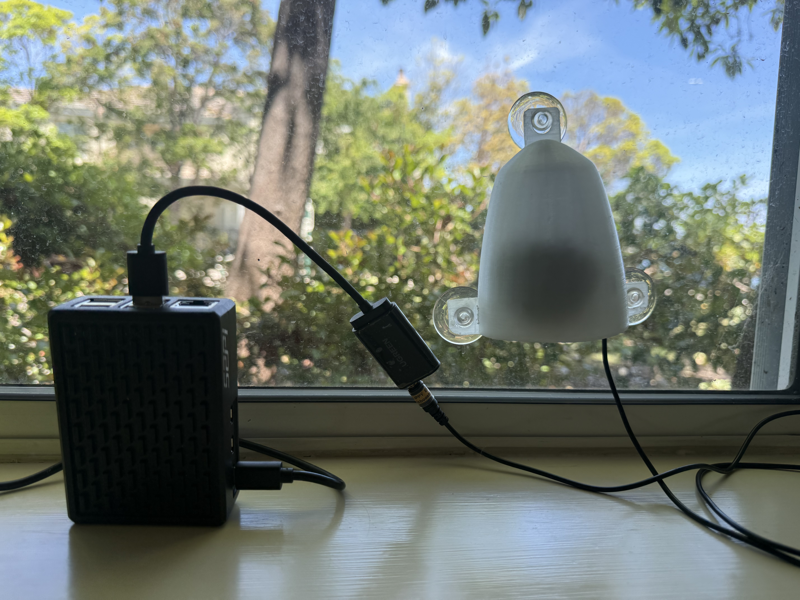
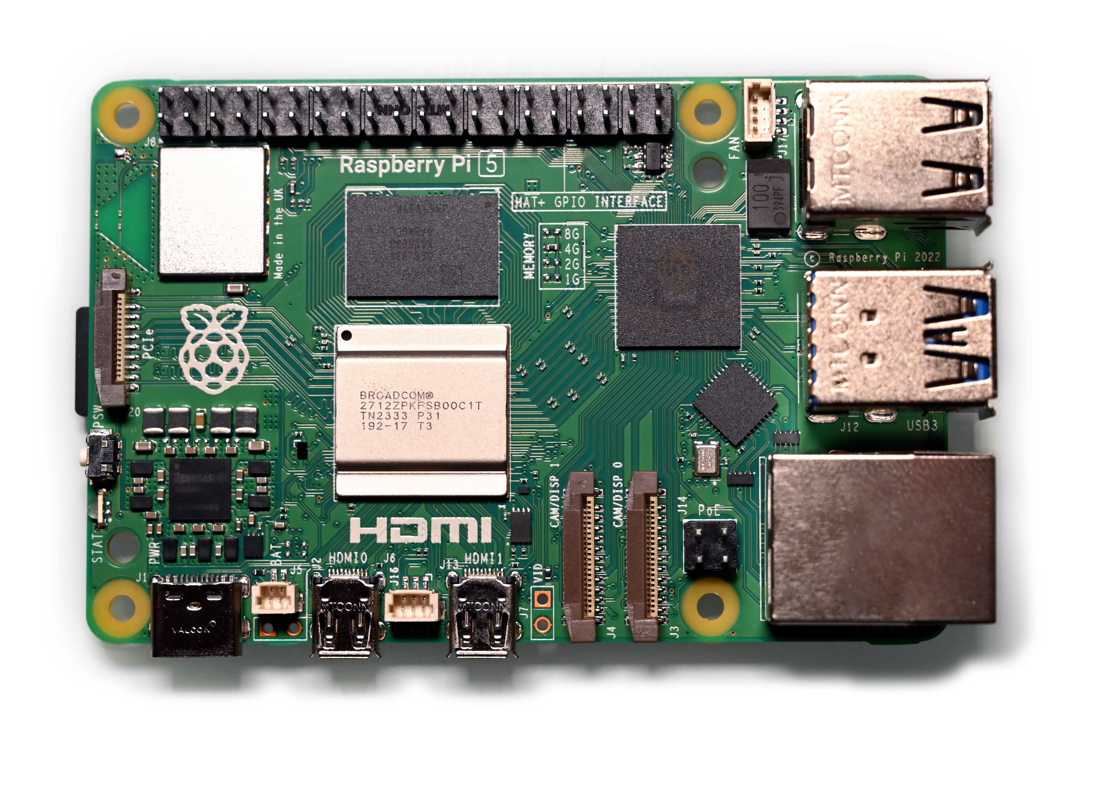
Meet Your Bird Detector! 🎙️
Raspberry Pi
The brain! Runs the bird-listening software.
🎙️
Outdoor Microphone
Sits outside in a weatherproof case. Listens 24/7!
Birdpi
📡
Network Connection
Sends results to a website you can check any time.
Powered by a tiny computer that’s smaller
than a deck of cards!
🔌
Power Cable
Plugs in indoors — simple setup!
Notes:
Image citation:
By SimonWaldherr - Own work, CC BY 4.0, https://commons.wikimedia.org/w/index.php?curid=144264842 (raspberry pi computer)

Slide 5
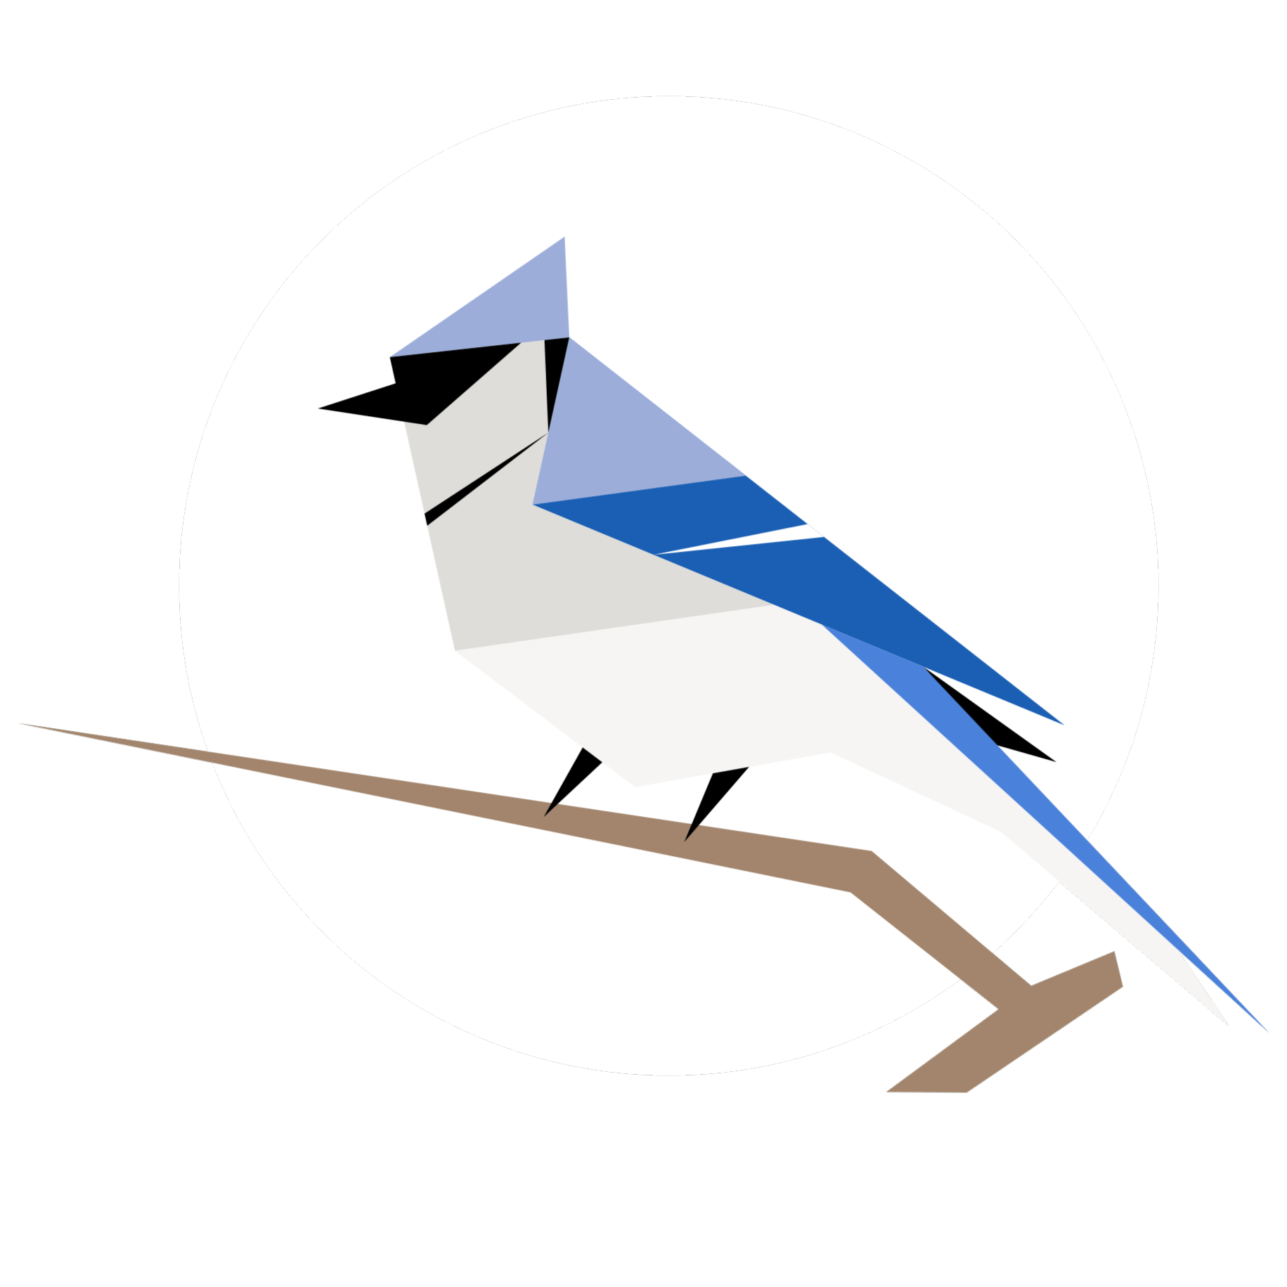
How Does It Work? ⚙️
🎙️
🔊
📊
🌍
Step 1
Step 2
Step 3
Step 4
Step 5
Mic records
bird sounds
outside
Audio sent to
Raspberry Pi
computer
AI listens &
identifies the
bird species
Results shown
on a local
website
Data shared
with scientists
worldwide!
💡 The BirdNet AI was trained on thousands of bird recordings — it can identify
over 6,000 bird species just by listening!
Notes:
Image: https://birdnet.cornell.edu/img/logo-birdnet-circle.png

Slide 6
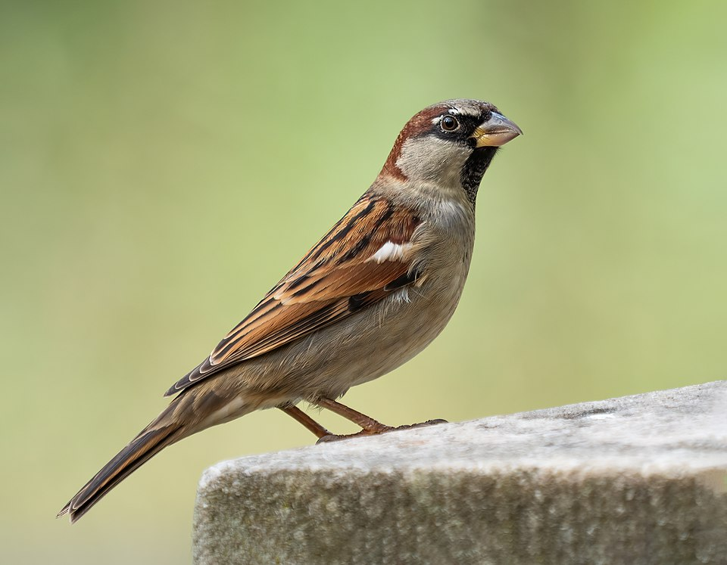
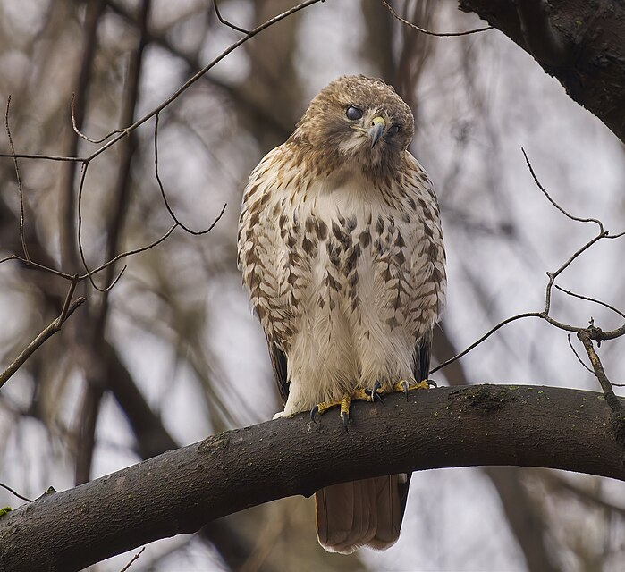
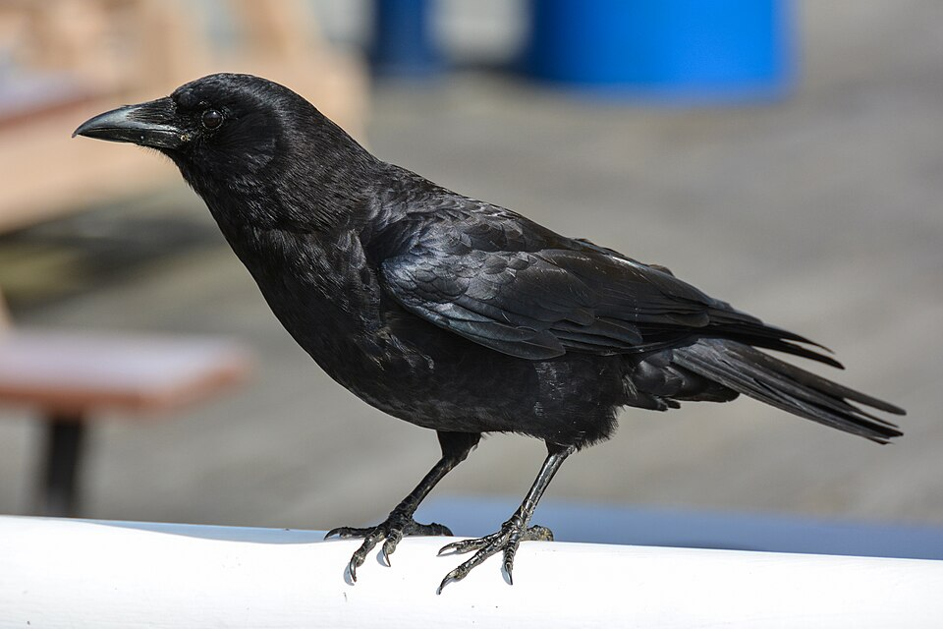
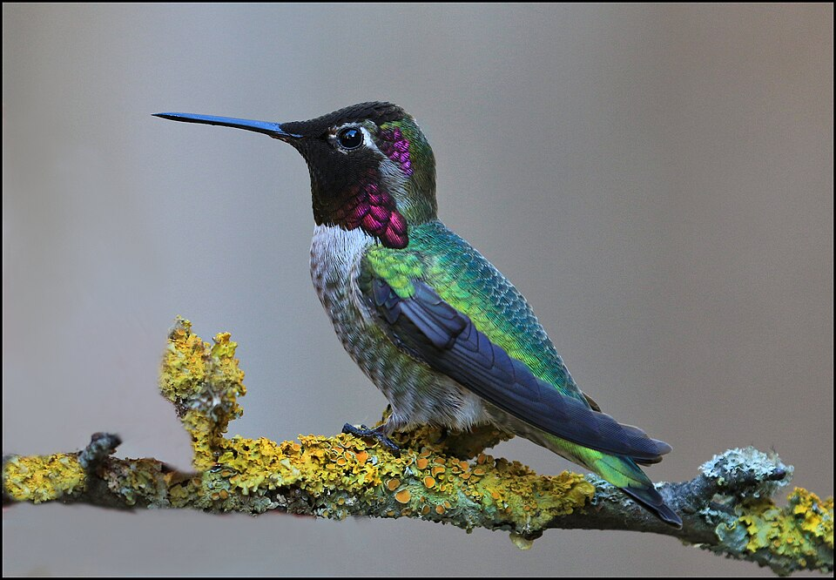
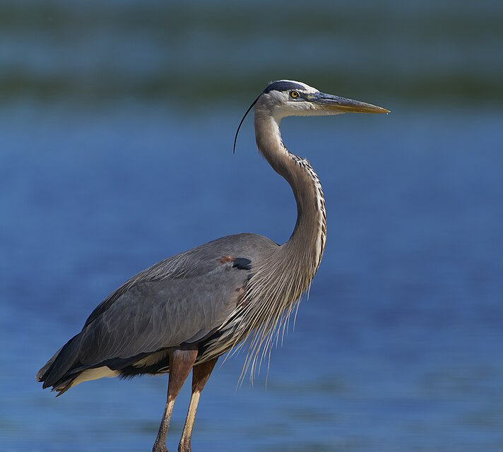
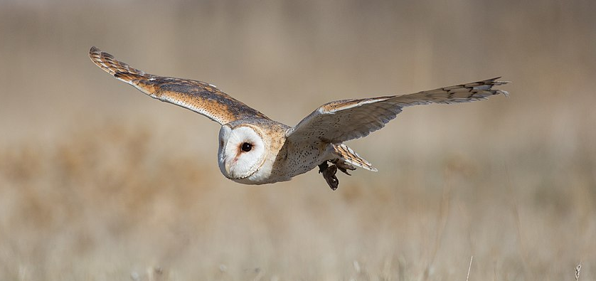
What Birds Might You Find? 🔍
House Sparrow
Red-tailed Hawk
American Crow
Loves urban areas — check schoolyards!
Often spotted circling overhead on warm days.
One of the smartest birds — can solve puzzles!
Anna's Hummingbird
Great Blue Heron
Barn Owl
Bay Area year-round resident. Tiny but mighty!
Stands very still while hunting fish.
Active at night — may detect calls after dark!
Notes:
Image citations:
Rhododendrites, CC BY-SA 4.0 <https://creativecommons.org/licenses/by-sa/4.0>, via Wikimedia Commons (sparrow)
Paul Danese, CC BY-SA 4.0 <https://creativecommons.org/licenses/by-sa/4.0>, via Wikimedia Commons (red-tailed hawk)
Photo: Gordon Leggett / Wikimedia Commons (American crow)
Nigel, CC BY 2.0 <https://creativecommons.org/licenses/by/2.0>, via Wikimedia Commons (Anna’s hummingbird)
Paul Danese, CC BY-SA 4.0 <https://creativecommons.org/licenses/by-sa/4.0>, via Wikimedia Commons (Great blue heron)
Carlos Delgado, CC BY-SA 4.0 <https://creativecommons.org/licenses/by-sa/4.0>, via Wikimedia Commons (Barn owl)

Slide 7
You Can Be a Real Scientist! 🔬
🧪 Citizen Science is when regular people — like YOU — help scientists collect real data!
📡
🌐
🏆
The Device Listens
Data Goes Global
Real Research Impact
Your school's BirdNet device records bird calls around the clock — no work needed from you!
Your detections are sent to BirdWeather, where scientists track bird populations worldwide.
You help track migration patterns, discover new species ranges, and monitor environmental health!
Your school's bird data becomes part of a global scientific database!

Slide 8
Sharing With the World 🌍
🌐 BirdWeather
10,000+
BirdWeather
stations worldwide
BirdWeather is a global platform that collects bird detection data from BirdNet stations everywhere.
When your school's device hears a bird, that detection gets logged to the BirdWeather map. Scientists and bird enthusiasts can see detections from YOUR school alongside data from stations around the world!
You can see cool stats like:
• Total birds detected
• Rarest species found
• Most active times of day
6,000+
Bird species
identifiable by AI
Millions
of detections
recorded every day

Slide 9
Class Activity Time! 🎉
💭 Think about it: What birds have you seen or heard near your school?
📋
1. Make a Prediction
Before the device starts, write down 5 birds you expect it to detect near your school. Compare your list with a partner!
🗺️
2. Map Your Results
Once data starts coming in, plot the bird detections on a map of your school grounds. Where are the birds most active?
📈
3. Track Changes
Check the data weekly! Do the types of birds change with the seasons? Make a simple graph of your findings.

Slide 10
The Birds Need You! 🐦
Here's how you can get involved with WREN:
🔭
📓
📸
🌱
Check the BirdNet
website at school
Keep a bird
journal or logbook
Try to photograph
birds you identify
Tell a friend about
citizen science!
WREN — Wildlife Research and Education Network
wreninitiative.org | birdweather.com | github.com/tphakala/birdnet-go | birdnet.cornell.edu

